Slide 1
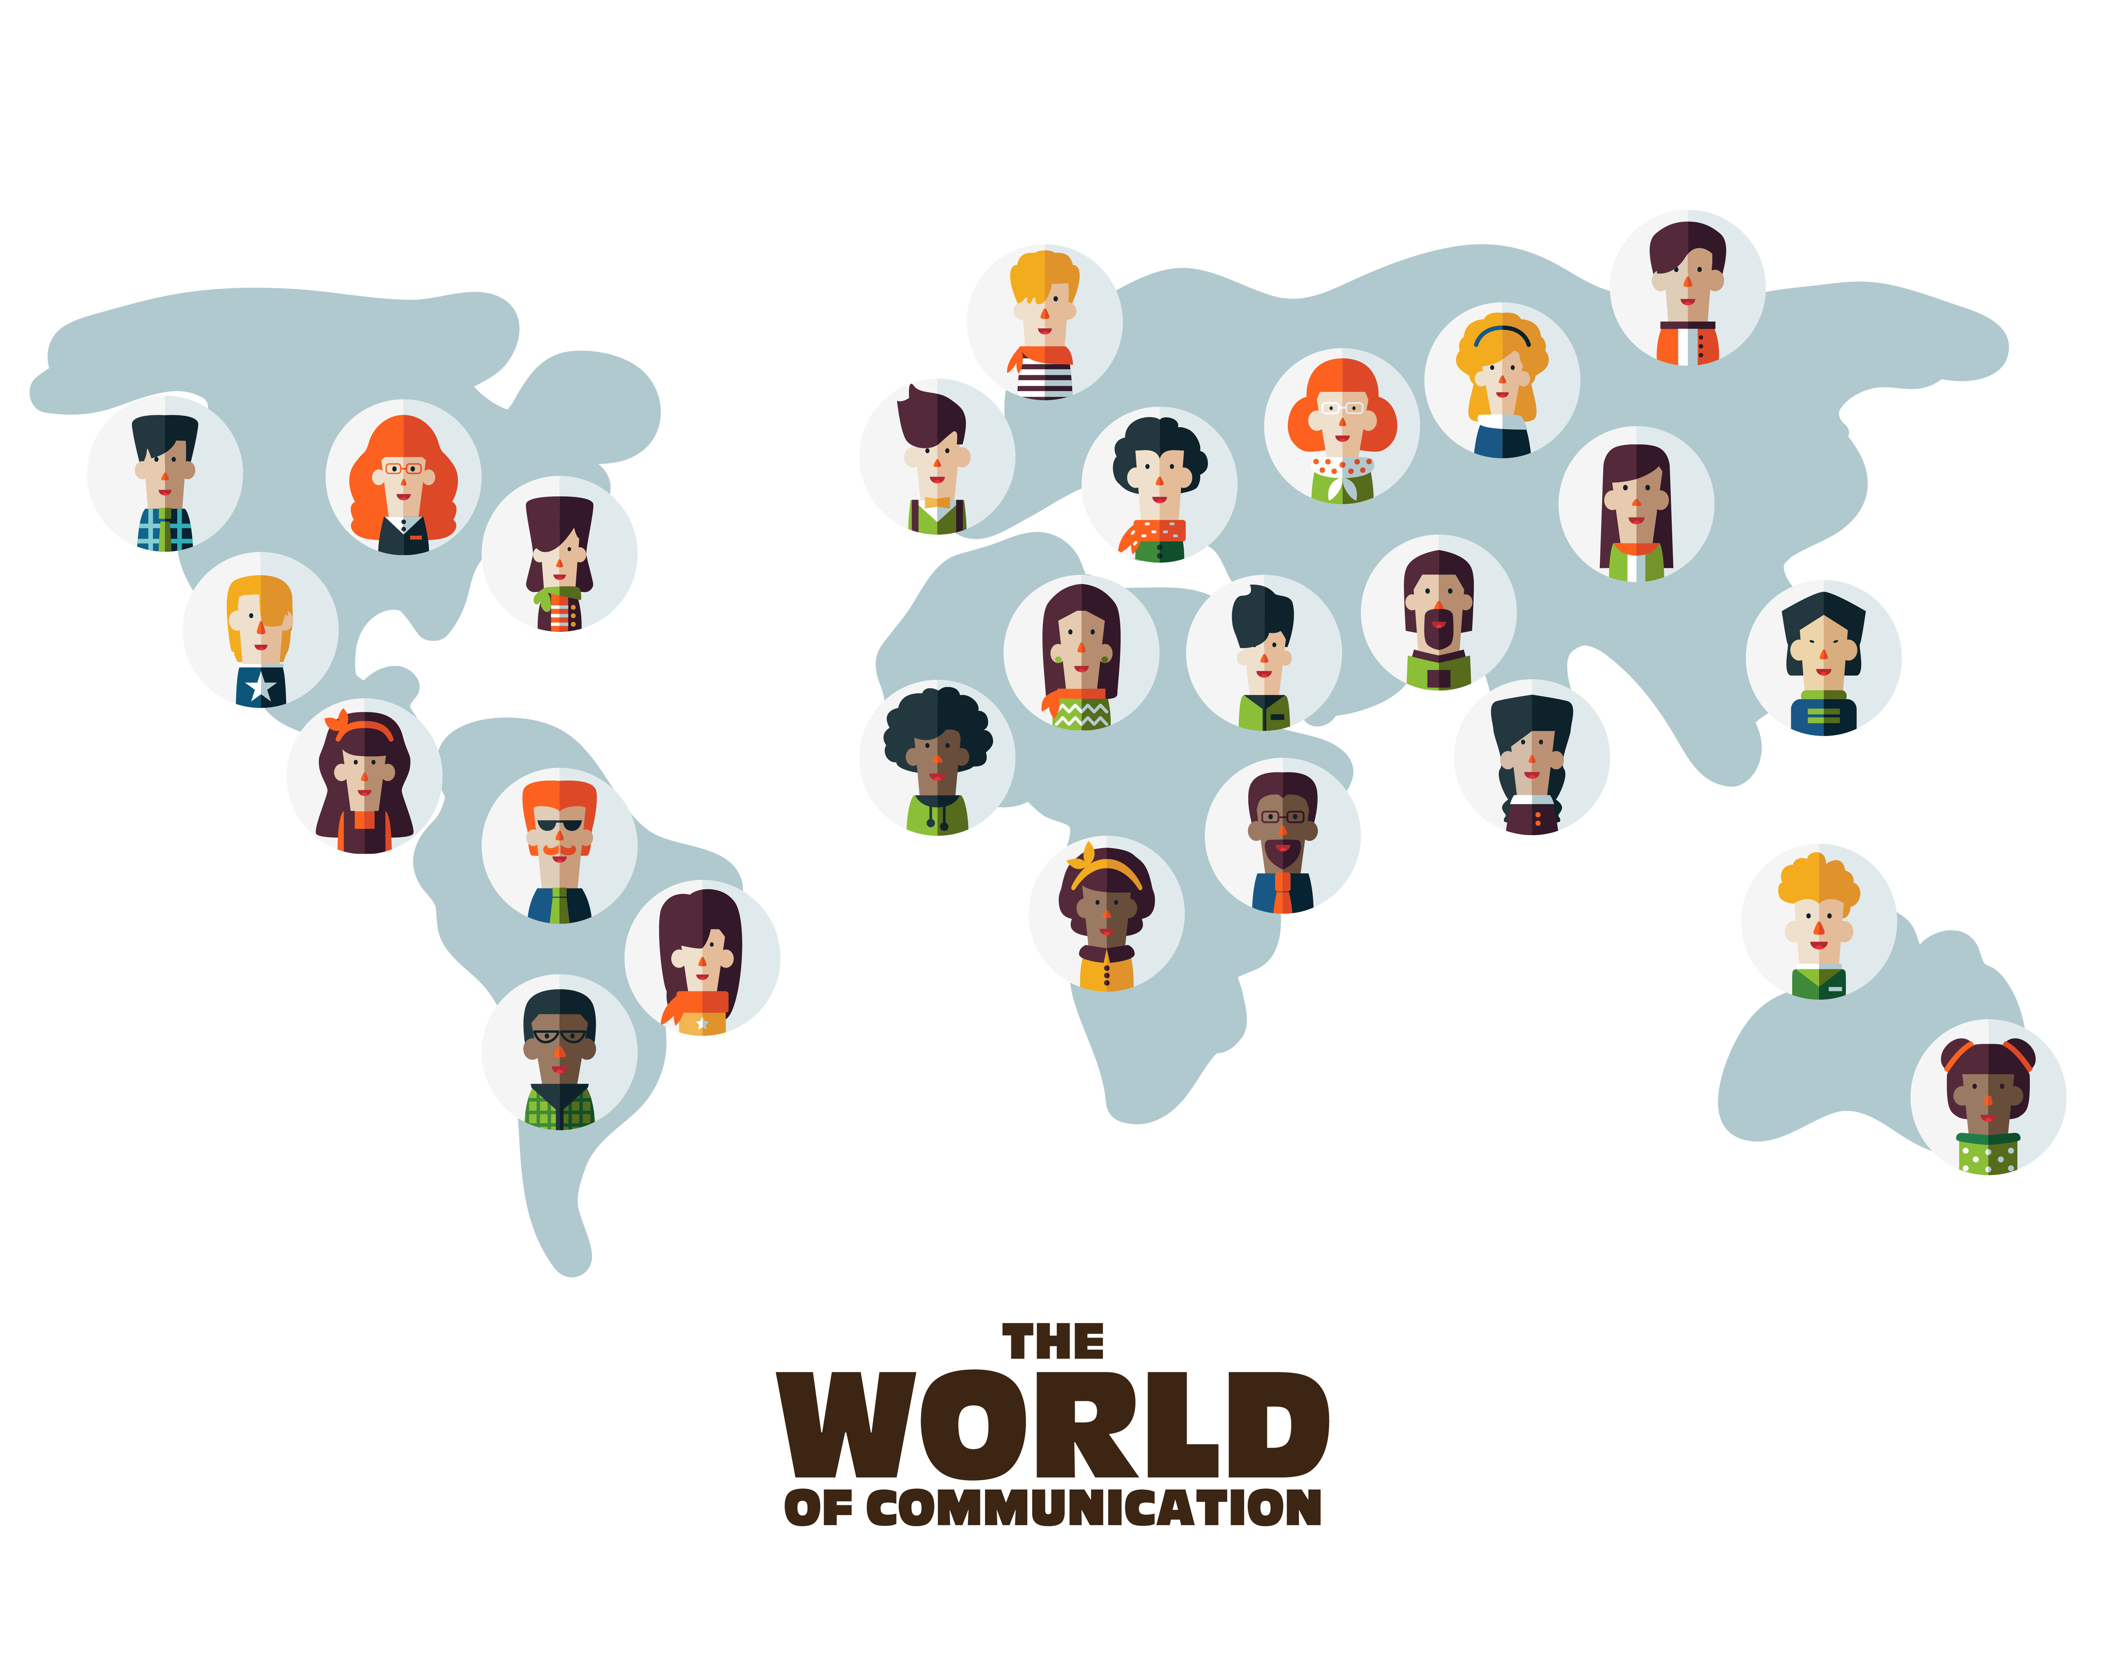

CC0003 Ethics and Civics in a Multicultural World
Week 11: Multiculturalism
Prof Walid Jumblatt Bin Abdullah

Slide 2
Learning Objectives
By the end of this lecture, you should be able to:
Explain the concept of multiculturalism.
Explain multiracialism in Singapore.

Slide 3
Outline
The following topics will be covered in this lecture:
Introduction
Multiculturalism
Multiracialism in Singapore
Conclusion

Slide 4
CC0003 Ethics and Civics in a Multicultural World
Week 11: Multiculturalism
Topic 01: Introduction
Prof Walid Jumblatt Bin Abdullah

Slide 5
Introduction
Most nations today are multi-ethnic.
Singapore is not ‘unique’ in this regard.
Multi-ethnicity is a fact of modern life.
Especially as borders became more porous.
Therefore, countries must think of ways to contend with multi-ethnicity.
Or do they?
Are differences necessarily a problem to be ‘managed’?
Or are differences a strength to be ‘celebrated’.
Multiculturalism is something that Singaporeans are always proud of.
But what exactly do we mean by it?
And what are some of the tensions that exist?

Slide 6
Introduction
Self-Government Rights
Territory, though part of the nation-state, is allowed autonomy to govern and make its laws in some spheres.
Political and territorial autonomy, for example, Quebec in Canada is mostly French-speaking and the culture differs from rest of Canada.
However, not always used, because states rarely ever wish to cede power and prospects of integration decrease dramatically.

Slide 7
Introduction: Types of Group-Specific Rights
Polyethnic Rights
The minorities have a right to their peculiarities without assimilation.
State funding for minority groups and their cultural associations.
Exemptions from certain laws:
Jews and Muslims in Europe from certain slaughtering laws.
Sikhs in Canada and Singapore from motorcycle helmet laws.
Muslims and Administration of Muslim Law Act (AMLA) in Singapore.
However, is this a violation of the principle of ‘equality’?

Slide 8
Introduction: Types of Group-Specific Rights
Special Representation Rights
Reservations for minority groups in the legislative bodies.
India and Singapore are among countries which use political affirmative action.
However, affirmative action comes with its own sets of problems.

Slide 9
Introduction: Justifications for Group-Specific Rights
Equality
True equality is not same-ness, but the accommodation of differences. (Kymlicka, 1997)
However, there are limits to this accommodation and there must be limits! But where are those limits?
Some minorities start from different points. Such as, Native Americans; Aborigines. (Alatas, 1977)
Role of Historical Agreements
For instance, the Malaysian constitution recognises the indigeneity of the Malays as does the Singapore constitution.

Slide 10
Introduction: Justifications for Group-Specific Rights
Singapore Constitution:
Article 152 (2)
The Government shall exercise its functions in such manner as to recognise the special position of the Malays, who are the indigenous people of Singapore, and accordingly it shall be the responsibility of the Government to protect, safeguard, support, foster and promote their political, educational, religious, economic, social and cultural interests and the Malay language.
Article 153
The Legislature shall by law make provision for regulating Muslim religious affairs and for constituting a Council to advise the President in matters relating to the Muslim religion.
Article 153A (2)
The national language shall be the Malay language…

Slide 11
Acknowledgements:
Slide 1 and 4: cristinn (n.d.). Set of social multi-ethnic people icons on World map. Male and female faces avatars. Communication and people connection vector concept [Photograph]. Adobe Stock Images. https://stock.adobe.com/sg/images/set-of-social-multi-ethnic-people-icons-on-world-map-male-and-female-faces-avatars-communication-and-people-connection-vector-concept/224165839
Slide 9: Kymlicka, W. (1997). Canadian Journal of Political Science / Revue Canadienne De Science Politique, 30(1), 182-183. http://www.jstor.org/stable/3232191
Slide 9: Alatas, S. H. (1977). The Myth of the Lazy Native. Routledge. http://www.citizens-international.org/ci2017/wp-content/uploads/2012/12/the-myth-of-lazy-native.pdf
Slide 10: Minorities and special position of Malays (Article 152), Constitution of the Republic of Singapore 09/2021. (2021). https://sso.agc.gov.sg/Act/CONS1963?ProvIds=P1XIII-. The Singapore legislation is subject to copyright of the Singapore Government and is reproduced with the permission of AGC. Users may consult SSO for the latest version of the Singapore legislation.
Slide 10: Muslim religion (Article 153), Constitution of the Republic of Singapore 09/2021. (2021). https://sso.agc.gov.sg/Act/CONS1963?ProvIds=P1XIII-. The Singapore legislation is subject to copyright of the Singapore Government and is reproduced with the permission of AGC. Users may consult SSO for the latest version of the Singapore legislation.
Slide 10: Official languages and national language (Article 153A), Constitution of the Republic of Singapore 09/2021. (2021). https://sso.agc.gov.sg/Act/CONS1963?ProvIds=P1XIII-. The Singapore legislation is subject to copyright of the Singapore Government and is reproduced with the permission of AGC. Users may consult SSO for the latest version of the Singapore legislation.

Slide 12
CC0003 Ethics and Civics in a Multicultural World
Week 11: Multiculturalism
Topic 02: Multiculturalism
Prof Walid Jumblatt Bin Abdullah

Slide 13

Multiculturalism: The Concept
Definition
Benefits
Multiculturalism is the political accommodation of minorities. Each group is allowed to retain its cultural specificities to the largest possible extent. Differences between human beings (and ethnic groups) are seen as a cause of celebration, not concern.
It is in line with the spirit of equality and liberty. Minorities are better able to feel at ease in the country and therefore, will be more productive citizens. More opportunities for cross-cultural learning.

Slide 14
Multiculturalism: The Other Side
To what extent should a ‘cultural’ demand be accommodated?
Examples:
Kidnap and rape by Hmong men in the West, who use their cultural practice of ‘marriage by capture’ as defence.
‘Honour killings’ by South Asian and Middle Eastern men.
Mother-child suicide among Japanese and Chinese women whose husbands were adulterous.
Then there are even the trickier examples:
The practice of the face veil (niqab).
Jehovah’s Witnesses and the carrying of arms.

Slide 15
Multiculturalism: The Other Side
Backlash from ordinary citizens
Manifested in Brexit, rise of far-right parties, and the election of Donald Trump.
Note that these phenomena are not due to racism or a rejection of multiculturalism per se; there are other (more pertinent) factors at play.
Such as the decimation of the middle-class and the manufacturing industry in the US due to the forces of globalisation and international trade.
However, a rejection of multi-culturalism is often linked to these occurrences too.

Slide 16
Multiculturalism: The Other Side
“
Quote by Nicolas Sarkozy, former French President
“It (multiculturalism) is a failure. The truth is that in all our democracies, we’ve been too concerned about the identity of the new arrivals and not enough about the identity of the country receiving them. This raises the issue of Islam and our Muslim compatriots. Our Muslim compatriots should be able to live and practise their religion like anyone else . . . but it can only be a French Islam and not just an Islam in France.”
~ (Heneghan, 2011)
“

Slide 17
Multiculturalism: The Other Side
“
Quote by David Cameron, former British Prime Minister
“Frankly, we need a lot less of the passive tolerance of recent years and much more active, muscular liberalism. Let's properly judge these organisations: Do they believe in universal human rights - including for women and people of other faiths? Do they believe in equality of all before the law? Do they believe in democracy and the right of people to elect their own government? Do they encourage integration or separatism?”
~(BBC, 2011)
“

Slide 18
Multiculturalism: The Other Side
“
Quote by Angela Merkel, German Chancellor
“Multiculturalism leads to parallel societies and therefore remains a ‘life lie’ (or a sham).”
~ (Noack, 2015)
“

Slide 19
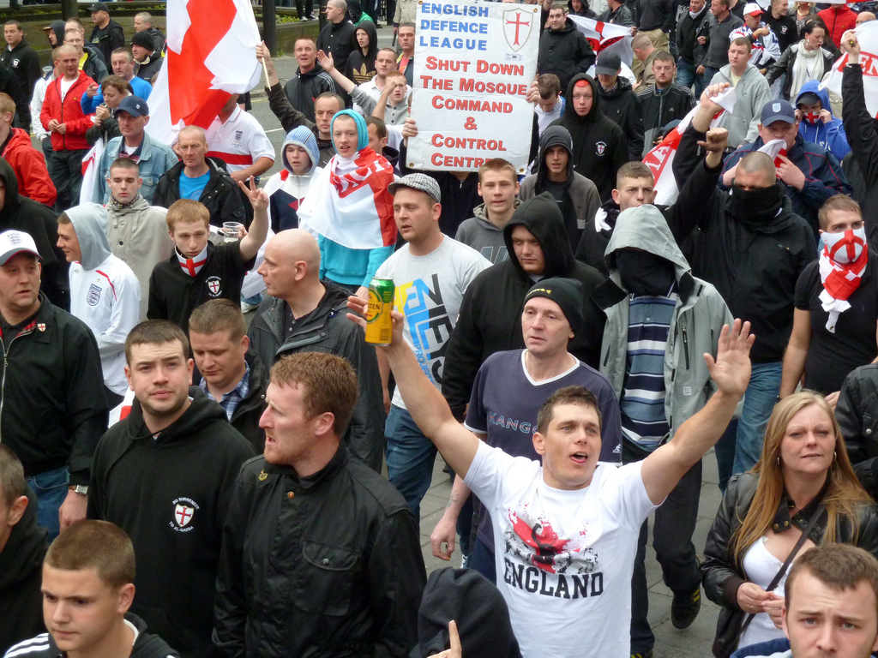
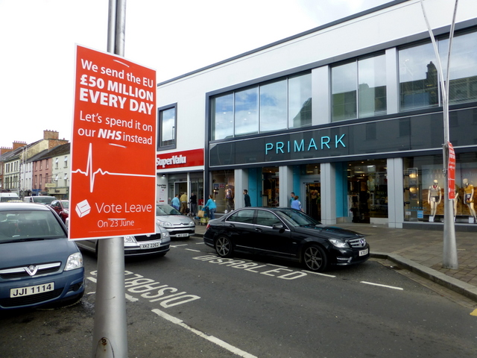
Multiculturalism: The Other Side
English Defence League demonstration
Vote in favour of Brexit poster

Slide 20
Acknowledgements:
Slide 12: cristinn (n.d.). Set of social multi-ethnic people icons on World map. Male and female faces avatars. Communication and people connection vector concept [Photograph]. Adobe Stock Images. https://stock.adobe.com/sg/images/set-of-social-multi-ethnic-people-icons-on-world-map-male-and-female-faces-avatars-communication-and-people-connection-vector-concept/224165839
Slide 16: Heneghan, T. (2011, February 12). Sarkozy joins allies burying multiculturalism. Reuters. https://www.reuters.com/article/us-france-sarkozy-multiculturalism-idUSTRE71A4UP20110211
Slide 17: BBC. (2011, February 5). State multiculturalism has failed, says David Cameron. BBC. https://www.bbc.com/news/uk-politics-12371994
Slide 18: Noack, R. (2015, December 14). Multiculturalism is a sham, says Angela Merkel. Washington Post. https://www.washingtonpost.com/news/worldviews/wp/2015/12/14/angela-merkel-multiculturalism-is-a-sham/
Slide 19: English Defence League. (2021, June 12). In Wikipedia. https://en.wikipedia.org/wiki/English_Defence_League
Slide 19: Vote Leave. (2021, July 21). In Wikipedia. https://en.wikipedia.org/wiki/Vote_Leave

Slide 21
CC0003 Ethics and Civics in a Multicultural World
Week 11: Multiculturalism
Topic 03: Multiculturalism in Singapore
Prof Walid Jumblatt Bin Abdullah

Slide 22
Multiracialism in Singapore
Singapore prides itself in being a multicultural/ multiracial society.
As per Hussin Mutalib, a Professor at NUS, the terms are used interchangeably, but he finds that multiracialism is more appropriate.
Singapore starts from the point that racial and religious differences are potential problems, and therefore need to be managed.
The government is unapologetic about this.
Singapore’s multiracialism is manifested in the Chinese-Malay-Indian-Others (CMIO) model.
No consideration for self-government approach whatsoever!
Approach is a mixture of ‘polyethnic rights’ and ‘special representation rights’.

Slide 23
Multiracialism in Singapore
“
Quote by Lee Kuan Yew, Former PM of Singapore
“I am often accused of interfering in the private lives of citizens. Yes, if I did not, had I not done that, we wouldn’t be here today. And I say without the slightest remorse, that we wouldn’t be here, we would not have made economic progress, if we had not intervened on very personal matters – who your neighbour is, how you live, the noise you make, how you spit, or what language you use. We decide what is right. Never mind what the people think.”
~ (BBC, 2015)
“

Slide 24
Multiracialism in Singapore
“
Quote by Lee Kuan Yew, Former PM of Singapore
“Had there been a Malay group that emerged, and they would have emerged easily if we had proportional representation, and not the first-past-the-post in each constituency, you consider the polarisation that would take place as they expound Malay rights and Malay language, and the policies which they think should prevail seeing what goes on around us, and the antagonisms which that would generate in reaction.”
~ (BBC, 2015)
“

Slide 25
Multiracialism in Singapore
“
Quote by Lee Hsien Loong, PM of Singapore
“We should not be shy to acknowledge that in Singapore, the majority is making a special effort to ensure that minorities enjoy full and equal treatment. We are not unique in making special arrangements for our Head of State. It is necessary in many multiracial countries. They make deliberate arrangements - either constitutional rules or conventions - but they have some kind of rotation or special representations for the minorities.”
~ (Tham, 2017)
“

Slide 26
Multiracialism in Singapore: The Composition

Slide 27
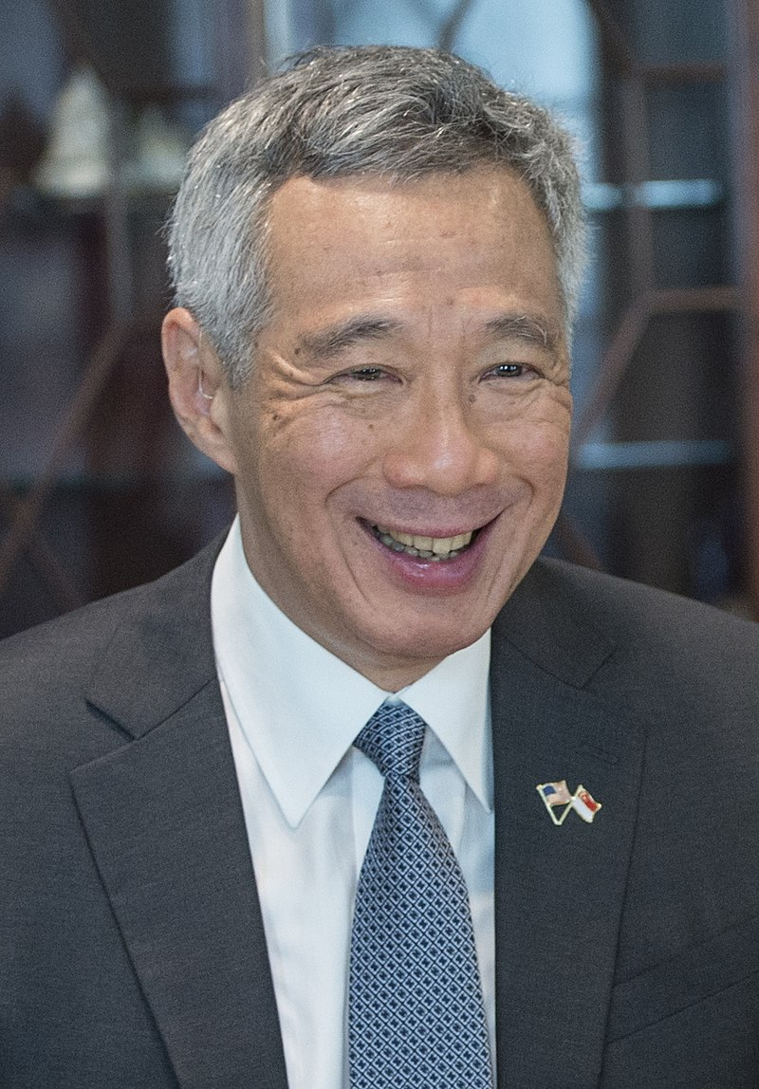
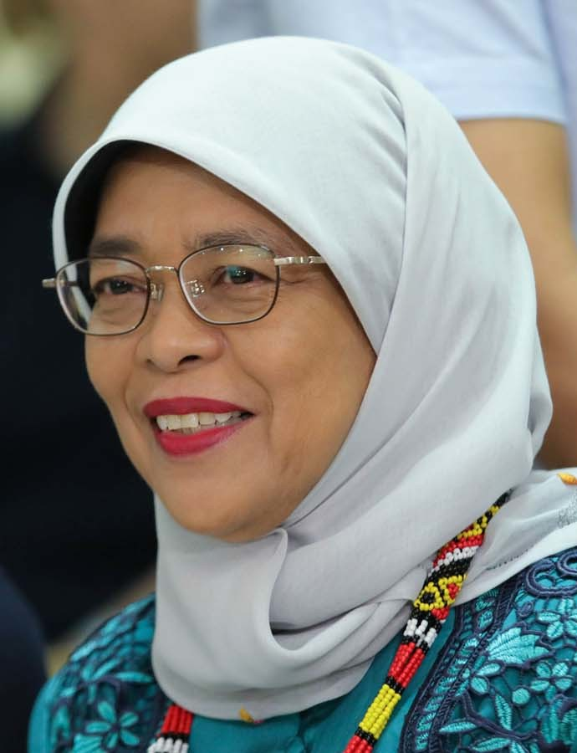
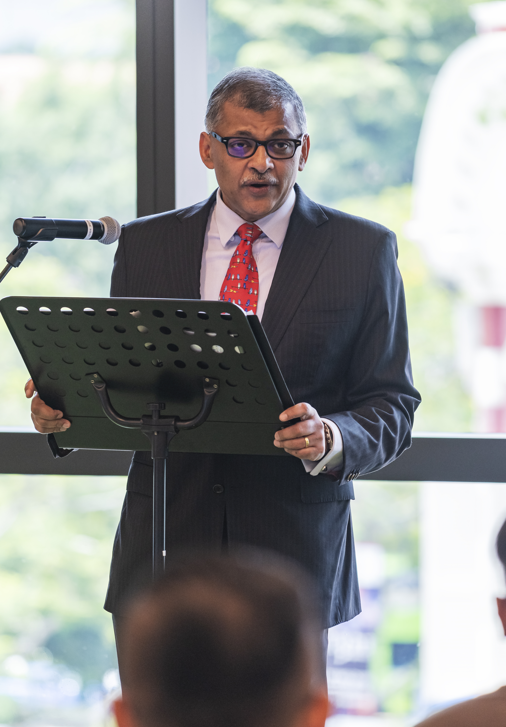
Multiracialism in Singapore
Lee Hsien Loong
Prime Minister of Singapore
Halimah Binti Yacob
President of Singapore
Sundaresh Menon
Chief Justice of Singapore

Slide 28
Multiracialism in Singapore
Singapore’s approach is highly Interventionist. It is a mixture of a few strategies:
Draconian Laws
Polyethnic Rights
Internal Security Act
Sedition Act
Maintenance of Religious Harmony Act
Special provisions for Muslims
Special Representation Rights
Others
Group Representation Constituencies (GRCs)
Reserved presidency
Inter-faith efforts
Housing quotas

Slide 29
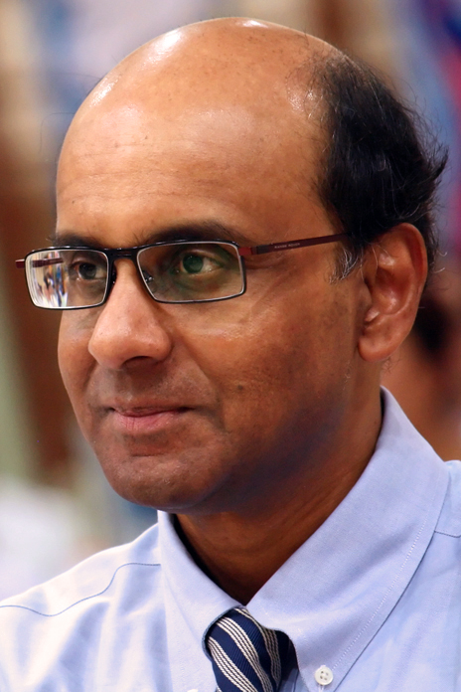
Multiracialism in Singapore: Tensions
1
Contradictions
Older generation of Singaporeans not ready for a non-Chinese Prime Minister
2
3
Tensions between meritocracy and multiracialism
Reserved Presidency and GRCs
Rising Xenophobia/ Racist incidents
Tharman Shanmugaratnam

Slide 30
Acknowledgements:
Slide 21: cristinn (n.d.). Set of social multi-ethnic people icons on World map. Male and female faces avatars. Communication and people connection vector concept [Photograph]. Adobe Stock Images. https://stock.adobe.com/sg/images/set-of-social-multi-ethnic-people-icons-on-world-map-male-and-female-faces-avatars-communication-and-people-connection-vector-concept/224165839
Slide 23: BBC. (2015, March 22). In quotes: Lee Kuan Yew. BBC. https://www.bbc.com/news/world-asia-31582842
Slide 24: BBC. (2015, March 22). In quotes: Lee Kuan Yew. BBC. https://www.bbc.com/news/world-asia-31582842
Slide 25: Tham, Y. (2017, September 30). Make minorities feel welcome, PM Lee Hsien Loong reminds Chinese Singaporeans. The Straits Times. https://www.straitstimes.com/politics/make-minorities-feel-welcome-pm-reminds-chinese-sporeans
Slide 26: Demographics of Singapore. (2021, July 11). In Wikipedia. https://en.wikipedia.org/wiki/Demographics_of_Singapore
Slide 27: Lee Hsien Loong. (2021, July 21). In Wikipedia. https://en.wikipedia.org/wiki/Lee_Hsien_Loong
Slide 27: Halimah Yacob. (2021, July 20). In Wikipedia. https://en.wikipedia.org/wiki/Halimah_Yacob
Slide 27: Sundaresh Menon. (2021, June 14). In Wikipedia. https://en.wikipedia.org/wiki/Sundaresh_Menon
Slide 29: Tharman Shanmugaratnam. (2021, July 7). In Wikipedia. https://en.wikipedia.org/wiki/Tharman_Shanmugaratnam

Slide 31
CC0003 Ethics and Civics in a Multicultural World
Week 11: Multiculturalism
Topic 04: Conclusion
Prof Walid Jumblatt Bin Abdullah

Slide 32
Conclusion
Multiculturalism is increasingly under attack in the West, especially from populist movements.
Not all populists are against multiculturalism.
We cannot divorce sentiments on race and religion from wider global and economic forces/ conditions.
When we use the terms multiculturalism and multiracialism, we need to be more careful.
What exactly do we mean?
Diversity is now a buzzword.
While important, we must be sure to ensure actual and not superficial diversity.
Racial progress is not unidirectional as the Western experience has shown.

Slide 33
Questions
Why is ‘integration’ even a virtue to be pursued in the first place?
What does an ‘integrated’ society look like?
Are modern nation-states destined to be fractious due to the inevitable racial and religious diversity?
Can Singapore afford to be more multicultural than multiracial?
Is Singapore ready for a non-Chinese Prime Minister, and what does the answer say about our state of affairs?

Slide 34
Acknowledgements:
Slide 31: cristinn (n.d.). Set of social multi-ethnic people icons on World map. Male and female faces avatars. Communication and people connection vector concept [Photograph]. Adobe Stock Images. https://stock.adobe.com/sg/images/set-of-social-multi-ethnic-people-icons-on-world-map-male-and-female-faces-avatars-communication-and-people-connection-vector-concept/224165839

Slide 35
